Slide 1
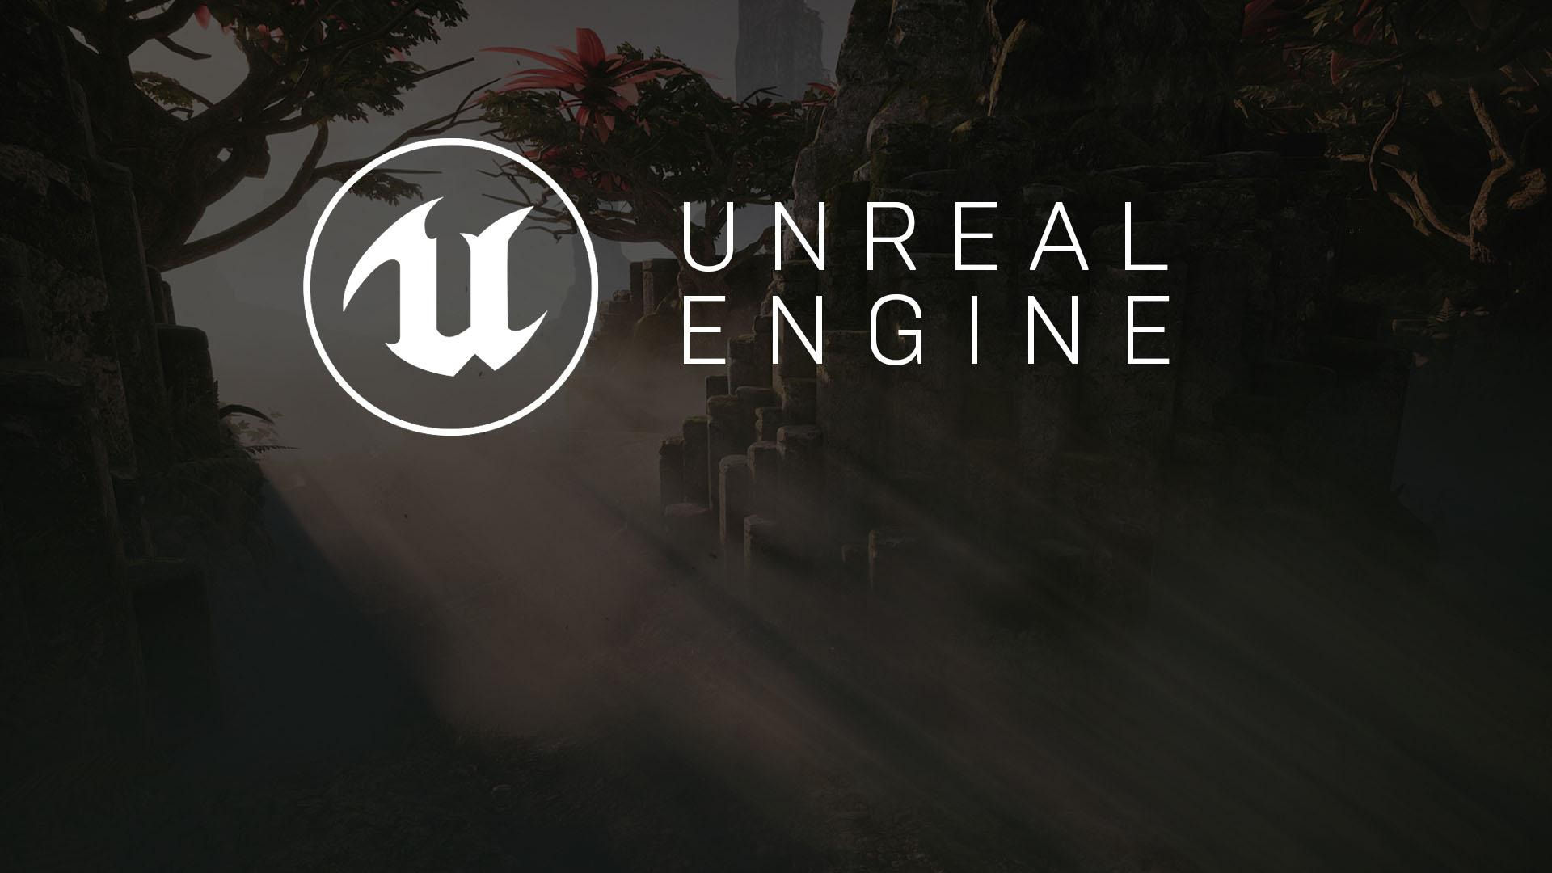
GAME DESIGN
A Breakdown of the Elements

Slide 2


HOW WOULD YOU DESCRIBE A GAME OF TAG?
If you were to describe a game of tag, you might do it like this:
In a game of tag, a collection of players run around a space, typically a schoolyard, avoiding a player that is considered “it.” Whenever a player that is “it” touches, or tags, another player, the tagged player becomes “it” while the original player is now no longer “it.” Players need to avoid being “it” for as long as possible. The game is over after a set amount of time.
While this description may be sufficient for describing the game to a friend, it fails to describe it in a game design context.

Slide 3
Space
It’s possible to break up the core elements into categories.
Goals
Actors
Mechanics
Rules

Slide 4
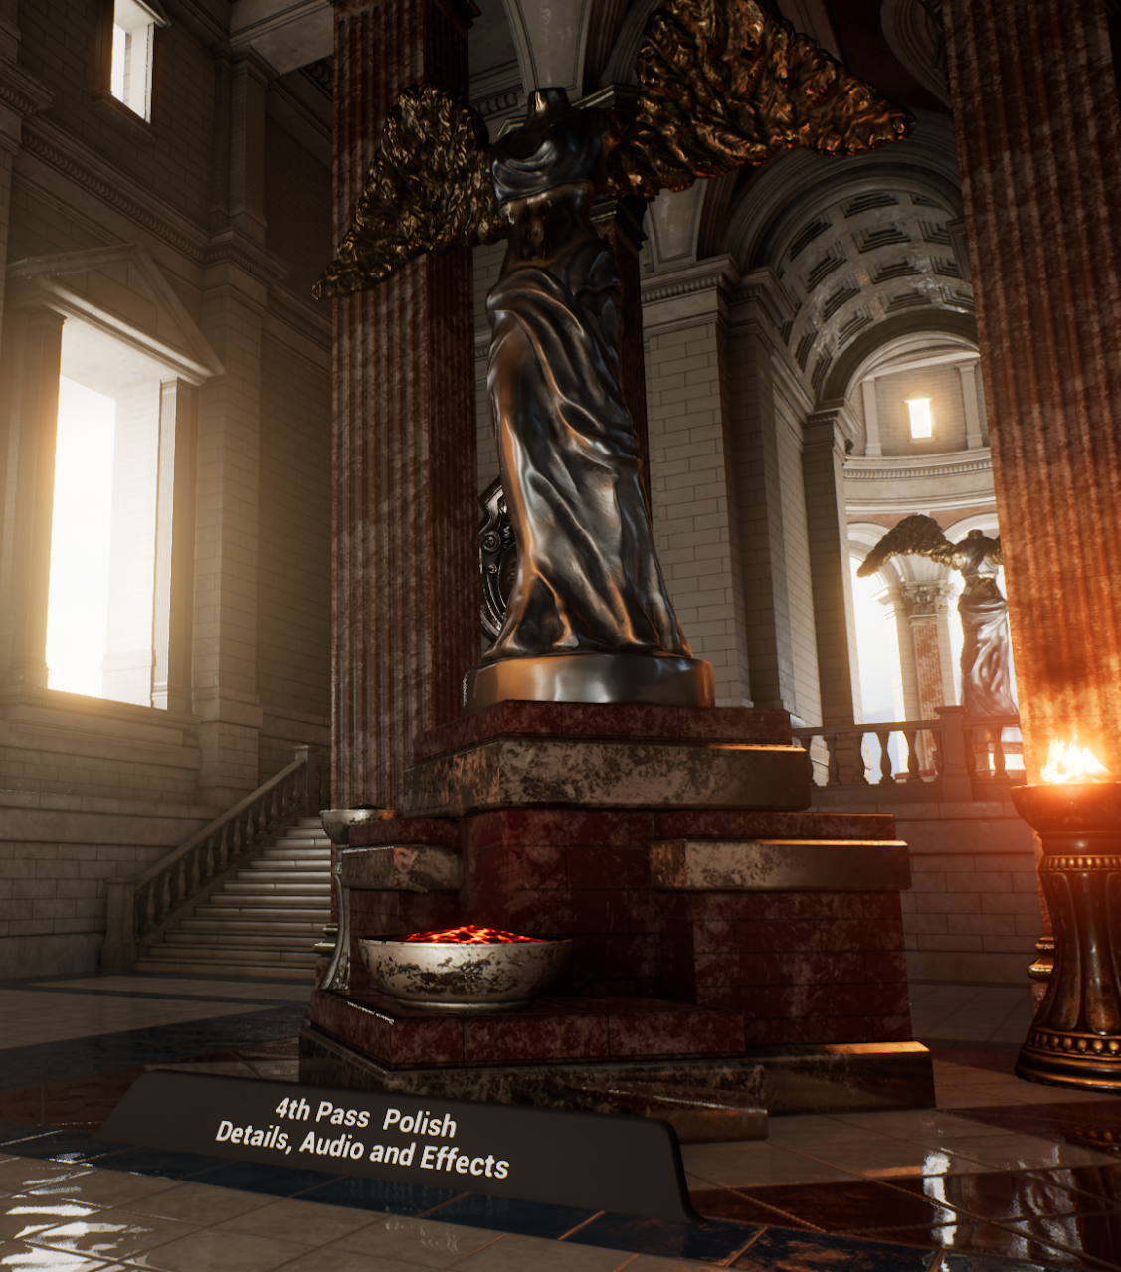
SPACE
The space is the environment in which the gameplay will take place. This description applies to both aesthetics and the design of the space.
Will the space be 2D or 3D?
Will the z axis matter to players?
How will cover and other environmental factors alter other design elements?
Will the gameplay take place in large open spaces or in tight corridors?

Slide 5
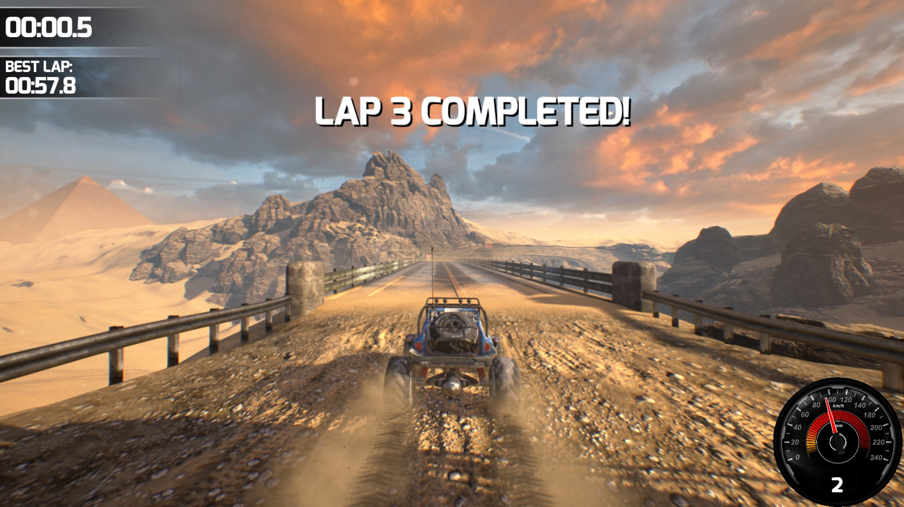
GOALS
The goals are what players must do to win or complete a game and represent the overall objectives to players. Should the player be completing a circuit? Knocking enemy players from the arena?

Slide 6
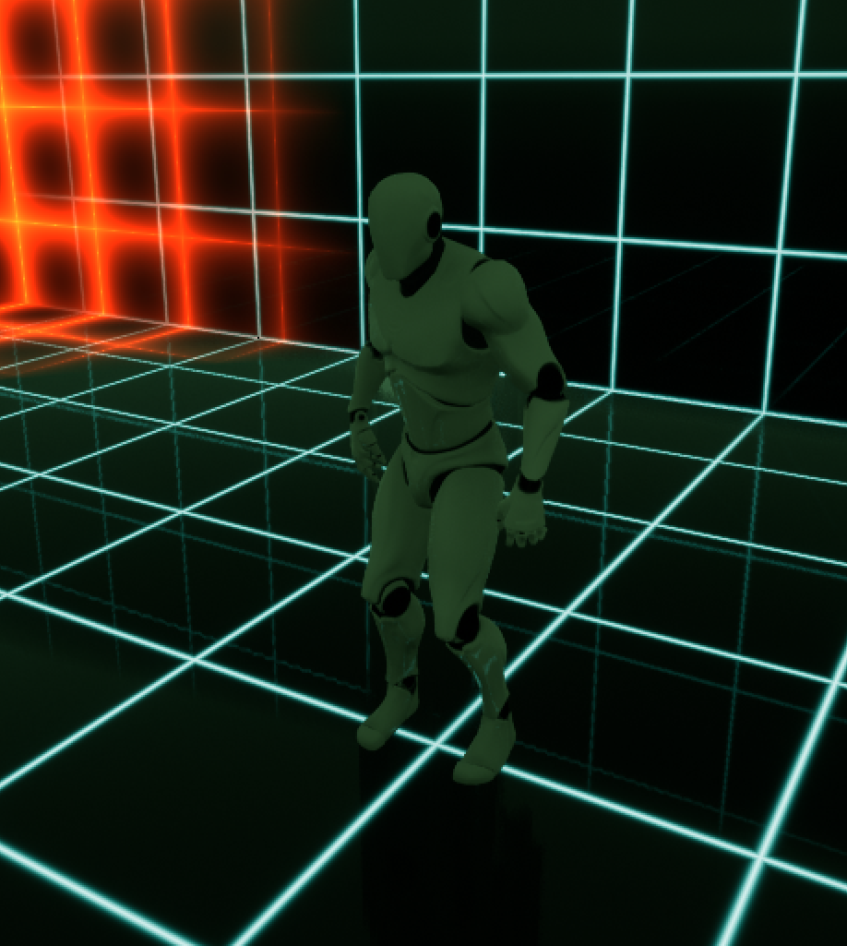
ACTORS
Actors are the main components within a game. They are the objects that are interacted with and controlled within the environment.
Players, weapons, and pickups are common types of actors.

Slide 7
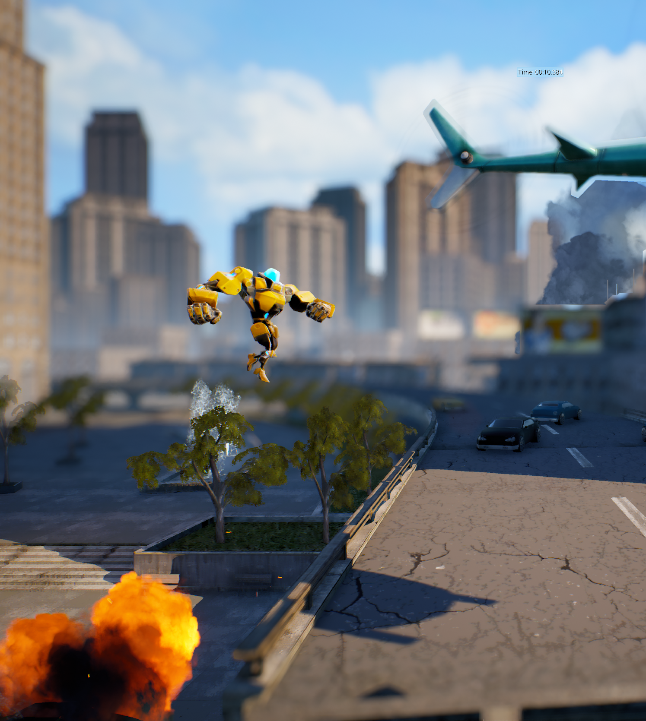
MECHANICS
Mechanics detail the actions that a player or other actors can do during the game. Sometimes mechanics are designed for compatibility between one another. For instance, while a player may be able to jump and slide, a new mechanic may be borne from sliding when landing.
Jumping, sliding, diving, and firing projectiles are all considered as different mechanics.

Slide 8
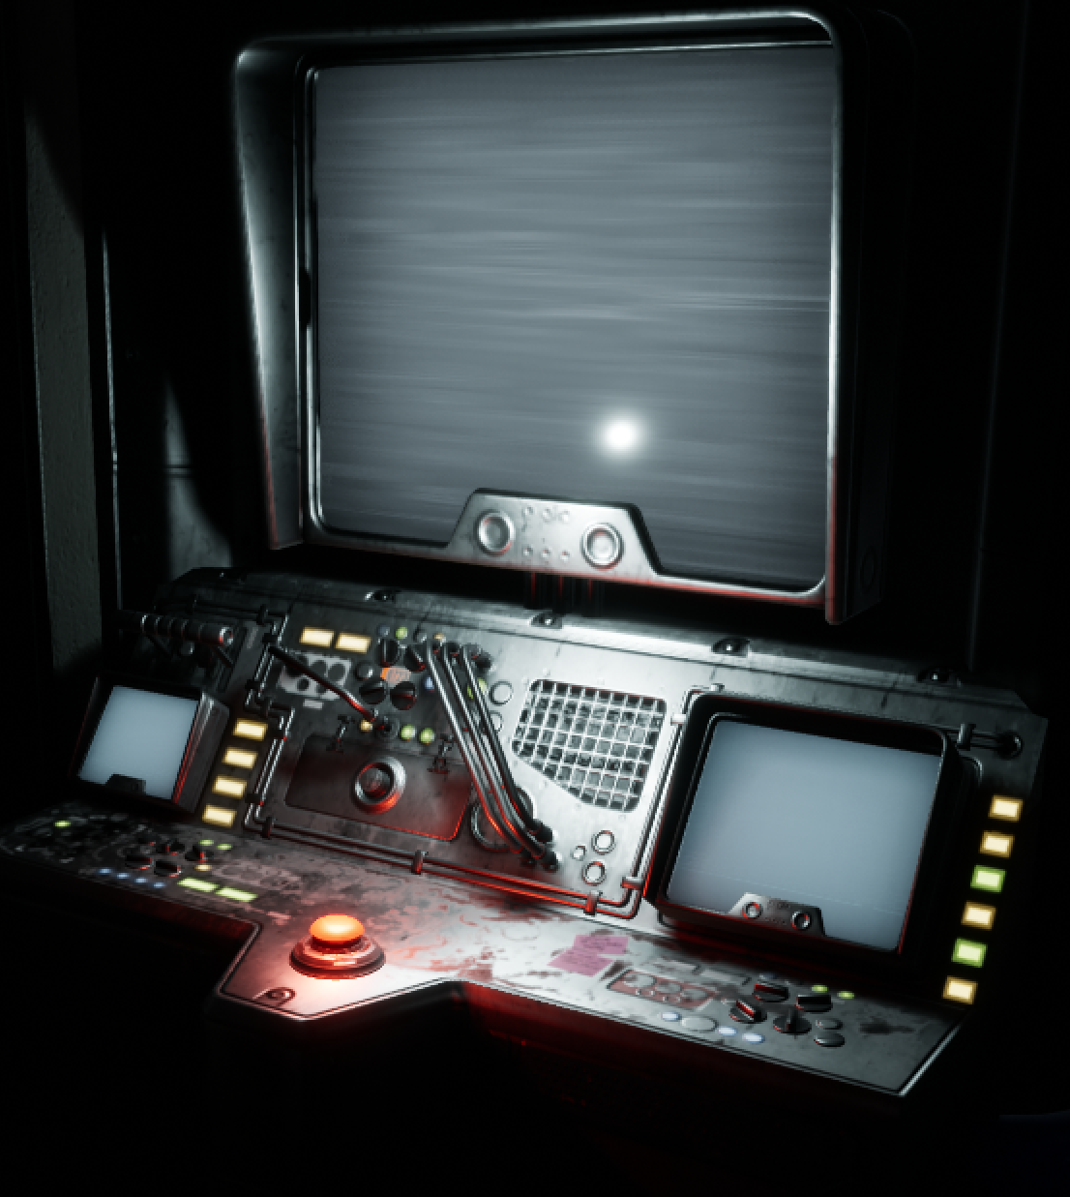
RULES
The rules describe how to play the game and the constraints in the game world. What must the players do to achieve their goals? What should they be wary of? What happens when a rule is broken? What happens if a rule is consistently adhered to?

Slide 9
Actors
The actors in the world are the players in the game of tag.
Mechanics
Therefore, in a game of tag . . .
The mechanics are that once tagged you become “it” and you change teams.
Goals
The goal is to avoid being tagged or to tag other players.
Space
The space is determined by the schoolyard play area.
Rules
The rules are that you cannot leave the space, tag back within x seconds, or climb trees.

Slide 10
PLAYER MOTIVATIONS
How to Make Players Do Something and
. . . Keep Doing It

Slide 11
What drives a player to keep playing?
Positive Reinforcement
Rewarding the player for performing behaviors that the designers would like to encourage
Negative Reinforcement
Taking away a negative stimulus when the player performs a desired action
Punishment
Applying a negative stimulus for performing an undesirable action
Studies have shown that while punishment is the most effective method of ensuring a player avoids performing a behavior, positive reinforcement at random intervals is the most effective for ensuring that a player continues to perform desirable actions, even in the absence of positive reinforcement.

Slide 12
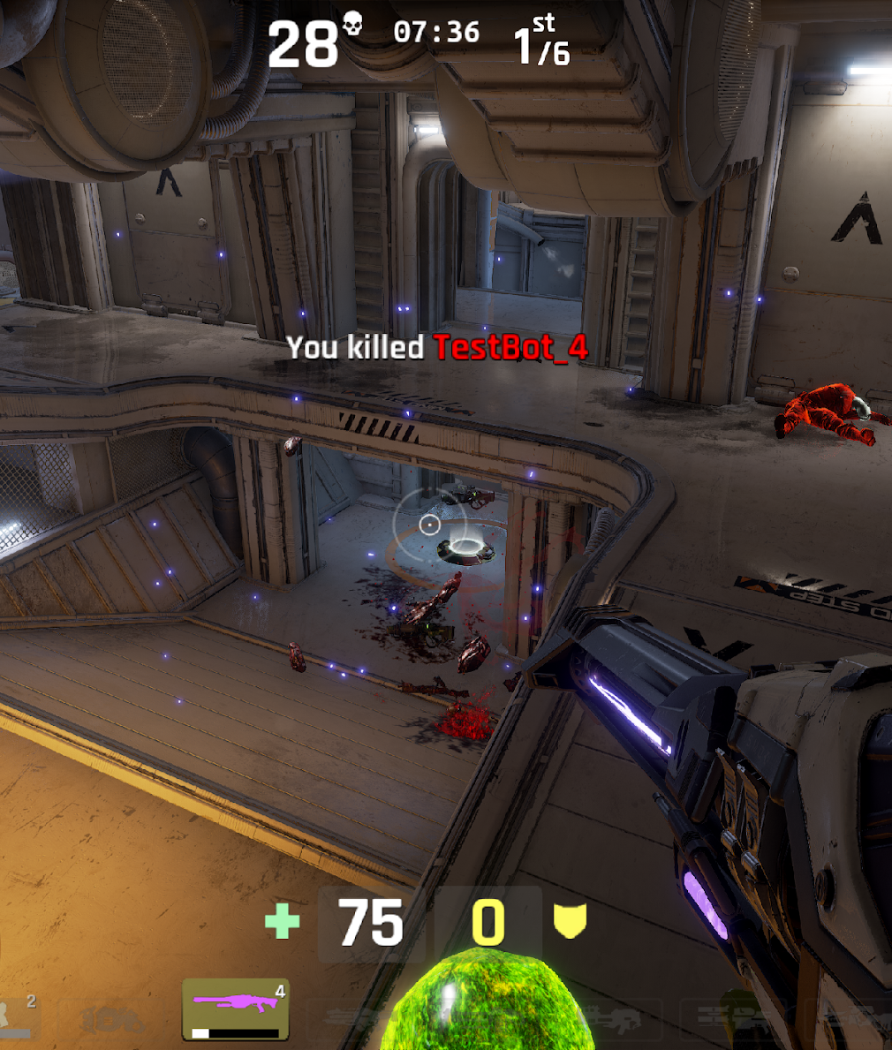
Positive Reinforcement
Armor
New weapons
New items
Negative Reinforcement
Defeat of enemies
Removal of tutorial prompts
Punishment
Player death
Loss of weapons
Loss of items

Slide 13
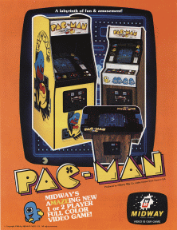
Pac-Man (1980)
Space:
2D, Fixed Camera, Single Screen
Goals:
When all of the dots are eaten, the player advances to the next level.
Eat dots and fruits to get a high-score.

Slide 14
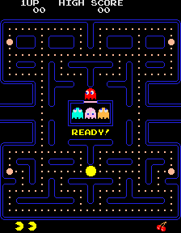
Pac-Man - Mechanics
1- 4 Directional 2D Movement: When the joystick held, Pac-man keeps moving.
2- Eating flashing dots known as power pellets: It provides you to eat ghosts until its effect time pass.
3- Upon eating a power pellet, they will turn into blue-colored ghosts which will flash white when they are about to turn back into their normal, lethal form.
4- Pac-Man can eat blue ghosts for bonus points; when eaten, their eyes make their way back to the center box in the maze.
5- Eating dots to gain points.
6- Eating a certain number of dots in a level will cause a bonus item, usually in the form of a fruit, to appear underneath the regeneration box, which can be eaten for bonus points.
7- Each fruits give different points. They spawn near of the center.
8- Each ghost acts different than the others.
9- If Pac-Man makes contact with a ghost, he will lose a life; the game ends when all lives are lost.

Slide 15
Pac-Man - Rules
1- The amount of time the ghosts remain vulnerable varies from one round to the next, but the time period generally becomes shorter as the game progresses. In later stages, the ghosts don't change colors at all, but still reverse direction when a power pellet is eaten.
2- Eating each pac-dot : 10 point, power pellet : 50 point,
3- Eating first ghost 200 and then the others' points x2.
4- When all of the dots are eaten, the player advances to the next level.
5- Game starts with 3 lives (UP).
6- Each 10.000 points gives a life.

Slide 16
Pac-Man – Positive Reinforcements
GAINING SCORE!!!
- Eating dots
Power pellets
Fruits.

Slide 17
Pac-Man – Negative Reinforcements
YOU ARE UNDER CONSTANT THREAT!!!
Ghosts pursuit you!
You can eat ghosts.
You can complete the level by eating pellets.

Slide 18
Pac-Man – Punishments
YOU LOSE YOUR PRECIOUS LIVES!
Ghosts take your lives.
0 Lives = Game Over!

Slide 19
Actors
Identify the actors of your game.
Mechanics
Identify the mechanics of your game.
Goals
ASSIGNMENT #2:
Explain a classic game considering the game design context elements.
Identify the goals of your game.
Space
Identify the space of your game.
Rules
Identify the rules of your game.
Positive Reinforcements
Identify your game's positive reinforcements.
Negative Reinforcements
Identify your game's negative reinforcements.
Punishment
To what effect does your game use punishments?

Slide 20
Super Mario Bros
Tetris
Flappy Bird
Duck Hunt
Donkey Kong
Sonic
Street Fighter I & II
Contra
Cut The Rope
90’s SNK and Capcom Games
Mega Man
Super Hot
Puzzle Bubble
Space Invaders
Galaga
Dig Dug
Paperboy
Tekken 1
DOS Games
Some Suggestions:
https://www.playretrogames.com/

Slide 21
LABWORK #5
Simple Platform Game

Slide 22
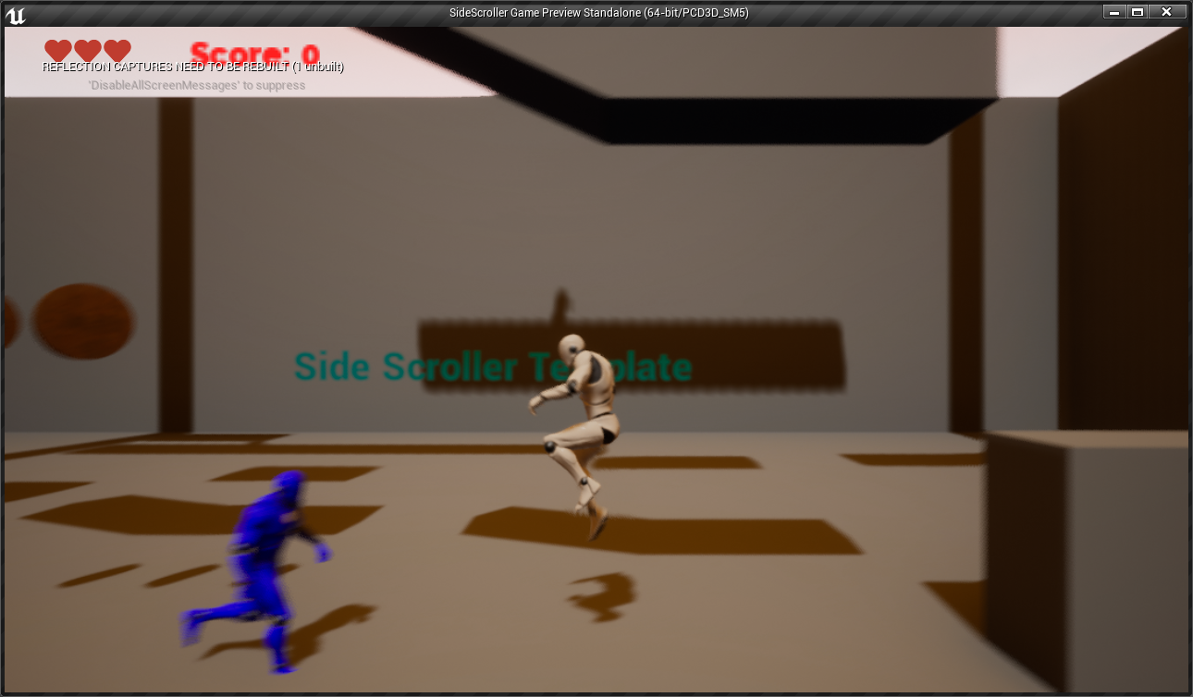
GAME CLASSES
The game created in this lecture is based on the Side Scroller Game template. The game uses four main Blueprint classes:
SideScrollerCharacter: A Pawn subclass that represents the player and is part of the Third Person template. This class is assigned to the Default Pawn Class parameter of the Game Mode.
BP_Gold: An Actor class that represents golds which can be collected and increase the score.
BP_HUD: Responsible for drawing the score and HitPoints of the player which are represented by heart icons.
BP_Enemy: A character based class which represents an enemy in the game world. This type of enemy walks left and right only.

Slide 23
GAME MECHANICS
The player can jump with Spacebar.
By holding jump button, player can stay in the air for an extra 0.5 seconds.
Any enemy can be defeated/damaged by jumping onto their heads.
When an enemy touches the player, player loses one health and starts blinking animation for 1.5 seconds. During this blinking period, the player is invulnerable and touching enemies won’t hurt them.
There is 1 type of enemy: blue.
Blue enemies walk on a platform. When they reach an edge or a wall, they just turn their back to opposite side.

Slide 24
GAME RULES
The player must reach the top of the map without losing all of his hit-points.
Game starts with 3 hit points.
The game is over when all hit-points are lost.
Each collected gold gives 10 points.
Damaging enemies by landing on their heads kill them.
Blue enemies give 50 killed.
The score and hit-point values will be drawn on the screen.

Slide 25
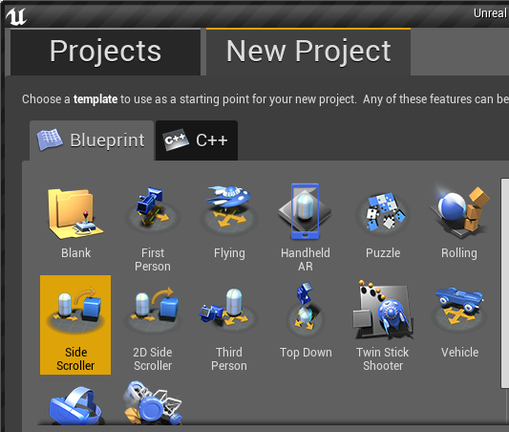
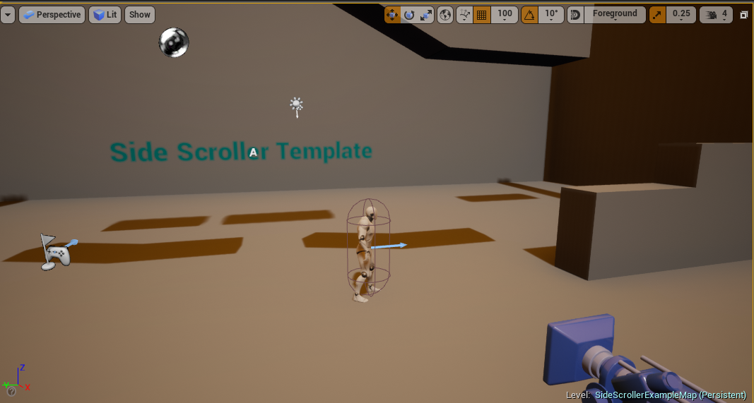
CREATING THE PROJECT
Create a new project using the Side Scroller template with starter content.
In the Content Browser, browse to SideScrollerBP/Blueprints folder to store all new Blueprints.

Slide 26
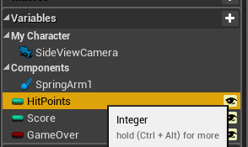
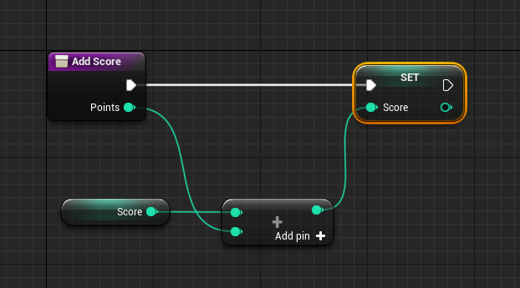
SIDESCROLLERCHARACTER
Open the SideScrollerCharacter.
Create the following Integer variables:
HitPoints: Stores the current Player’s hit points. Set default value to 3.
Score: Stores the player’s score.
Add AddScore(points) Function.
Create the following Boolean variable:
GameOver: Indicates if the game has ended.

Slide 27
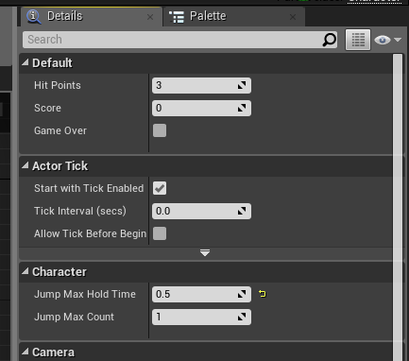
JUMP MECHANIC SETUP
Open SideScrollerCharacter and goto Class Defaults.
Set JumpMaxHoldTime to 0.5.
Open CharacterMovement component and set Jump Z Velocity to default (=420)

Slide 28
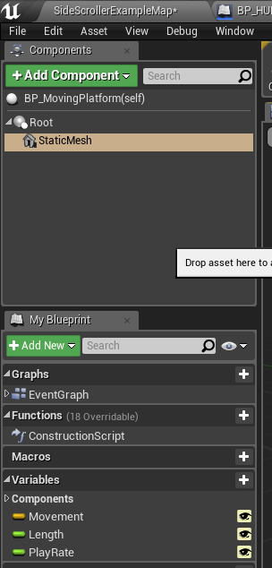
BP_MOVINGPLATFORM
Create a new Blueprint class and choose “Actor” as the parent class. Name it “BP_MovingPlatform”.
Add a Static Mesh component and select “1M_Cube” as the static mesh.
Add Length (Default =4.0) and PlayRate(Default =1.0) float variables.
Add Movement Vector variable and set the default to (X=0,Y=0,Z=400)

Slide 29
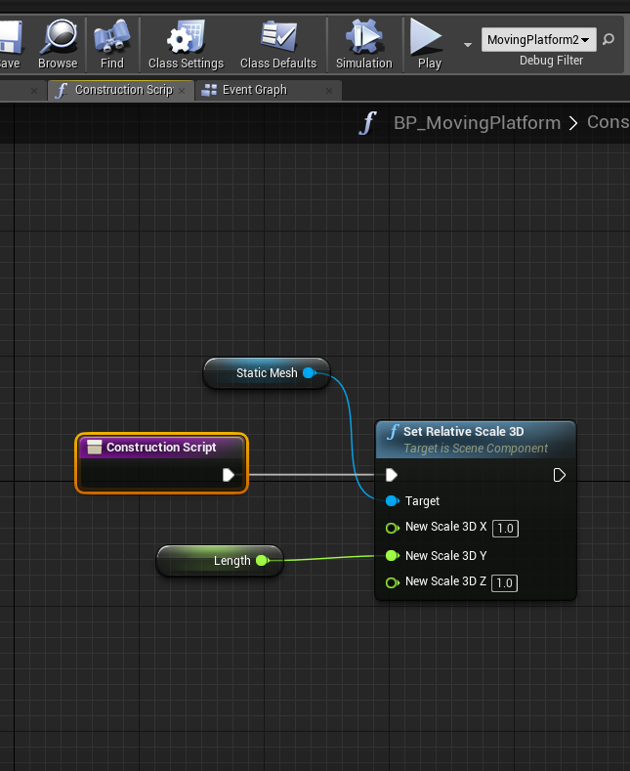
BP_MOVINGPLATFORM :
CONSTRUCTION SCRIPT
Make the staticmesh editor editable by pluging the Length variable into its Relative Y Scale.

Slide 30
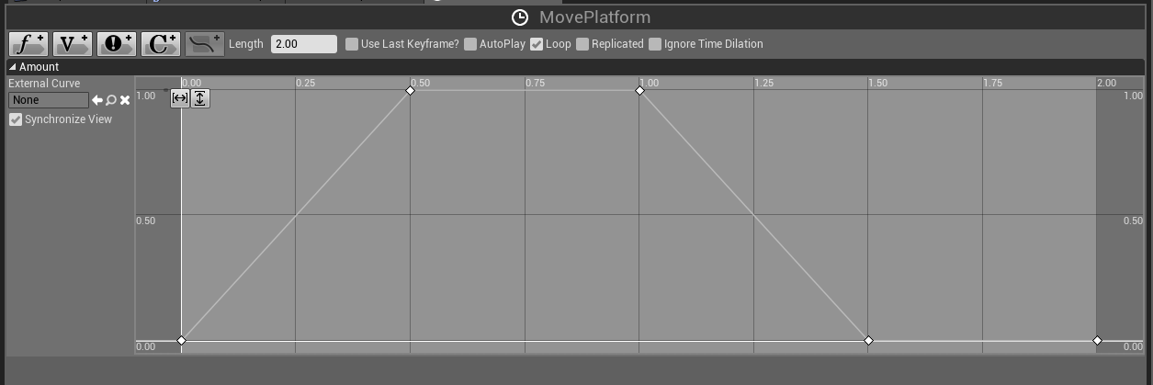
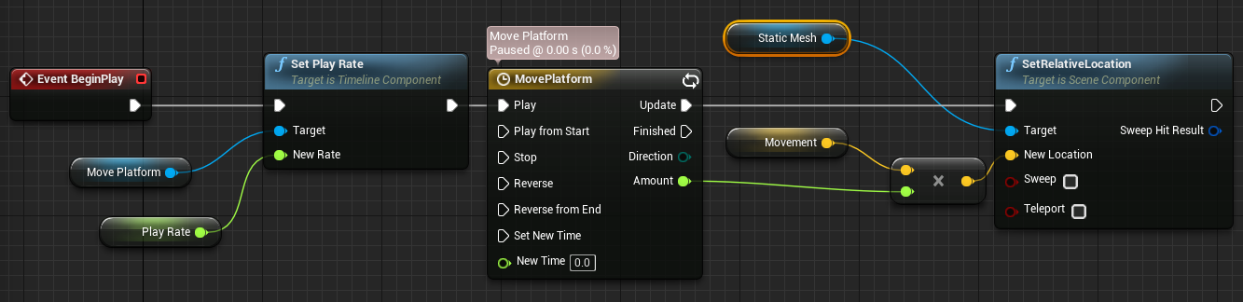
Timeline curve of 2 secs in length:
BP_MOVINGPLATFORM : ADD TIME LINE
Goto Event Graph and select Add TimeLine..
Name it to MovePlatform
Add BeginPlay event

Slide 31
BP_HUD
Create a new Blueprint class and choose “HUD” as the parent class. Name it “BP_HUD”.
This reference will be used to access the variables that will be drawn on the screen.
Browse the internet and Import a hearth texture (png, transparent) to be drawn as the player’s hitpoints.

Slide 32
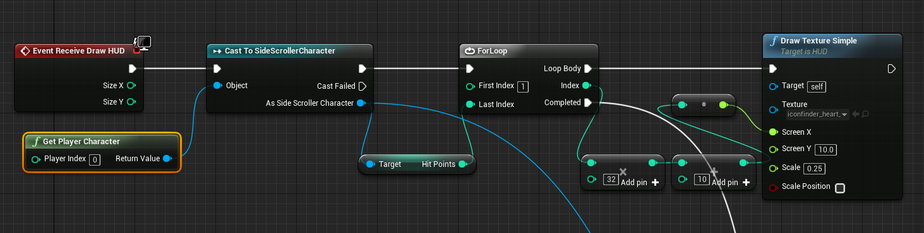
BP_HUD:
RECEIVE DRAW HUD 1/2
To draw on the screen, the Receive Draw HUD event must be added to the Event Graph. This event is available only in Blueprints based on the HUD class.
The Draw Text function of the HUD class is used to print the score on the screen, as shown in the image on the right.

Slide 33
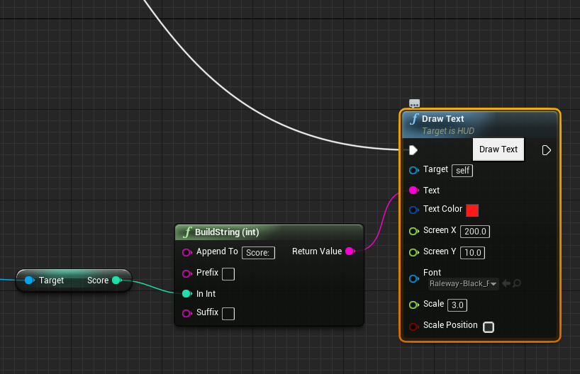
BP_GUIDE_HUD: RECEIVE DRAW HUD 2/2
The BuildString (int) function is used to produce a string containing the text “Score:” plus the current value of the Score variable. The resulting string is passed to the Text parameter of the Draw Text function.
The only changes in the Draw Text function involve the parameters Text, Text Color, and Screen X.
You can also browse the internet for a TTF font and import it into your game as a new font to be used in DrawText node.

Slide 34
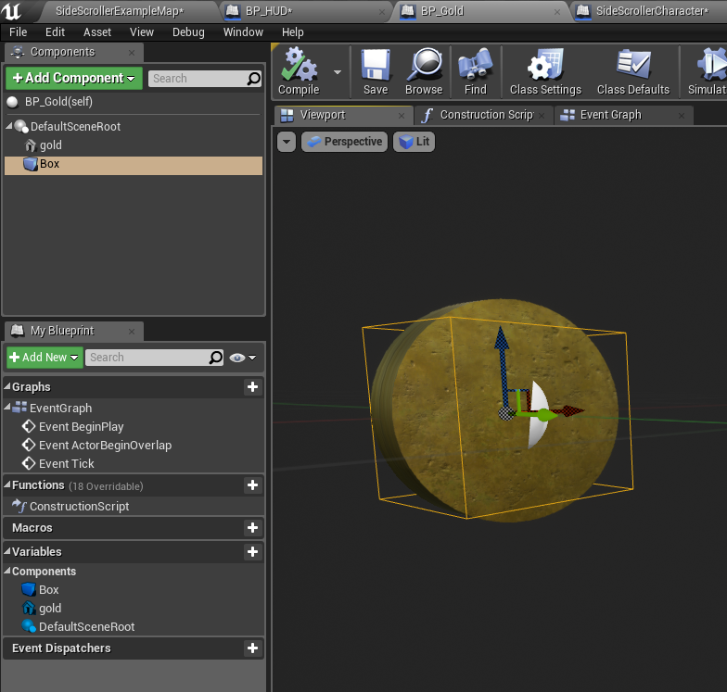
BP_GOLD
Create a new Blueprint class and choose “Actor” as the parent class. Rename it “BP_Gold”.
Add a Static Mesh component. In the Details panel for the Static Mesh component, set the Static Mesh property to “Cylinder”.
Set the Element 0 property in the Materials category to “M_Metal_Gold”.
Set the Collision Presets property to “OverlapAllDynamic”.
Set RelativeScale of the static mesh Y=0.5.
Add a Box Collision component at the DefaultSceneRoot. And set its bounds around the cylinder.
Compile and save your Blueprint class.
Add instances of the BP_Gold Blueprint to the Level at any location.

Slide 35
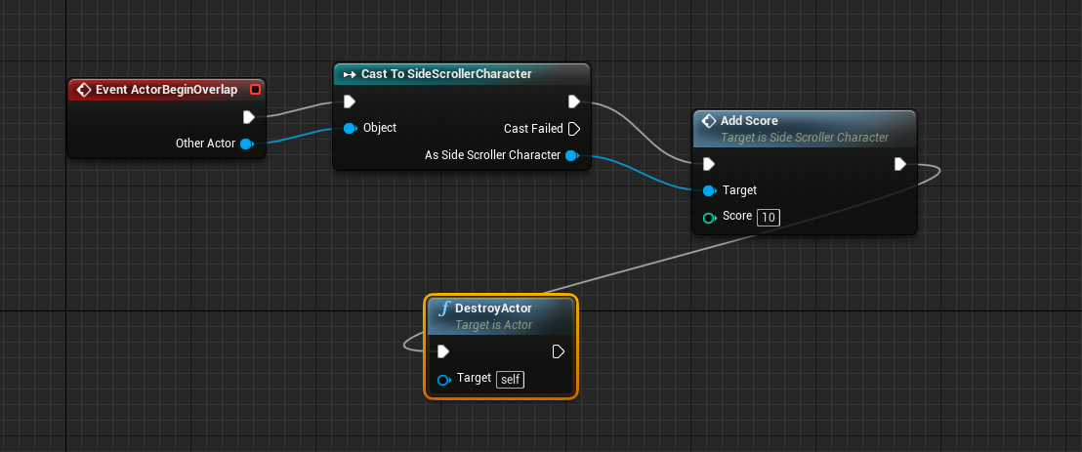
BP_GOLD:
EVENT ACTOR BEGIN OVERLAP
The image on the right shows the ActorBeginOverlap which is called in case a player character overlaps with the gold. Thus it gives the player the score, destroys itself.

Slide 36
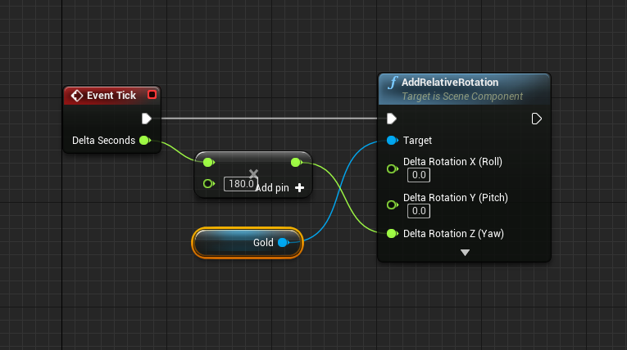
BP_GOLD:
EVENT TICK
Add the TickEvent to the event graph.
Call RelativeRotation on the static mesh to make it rotate 180 degree in one second.

Slide 37
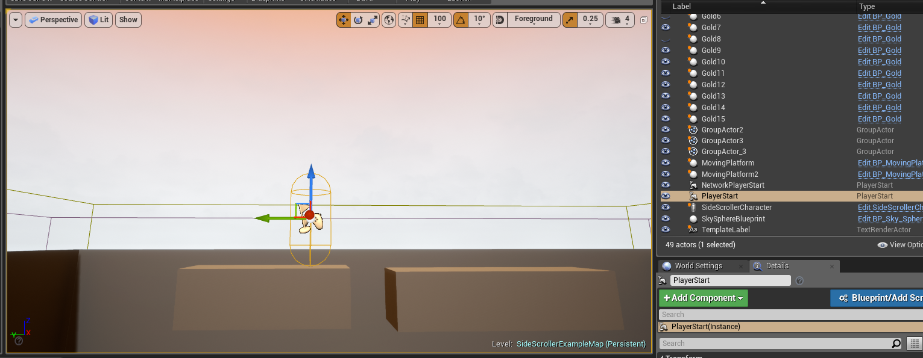
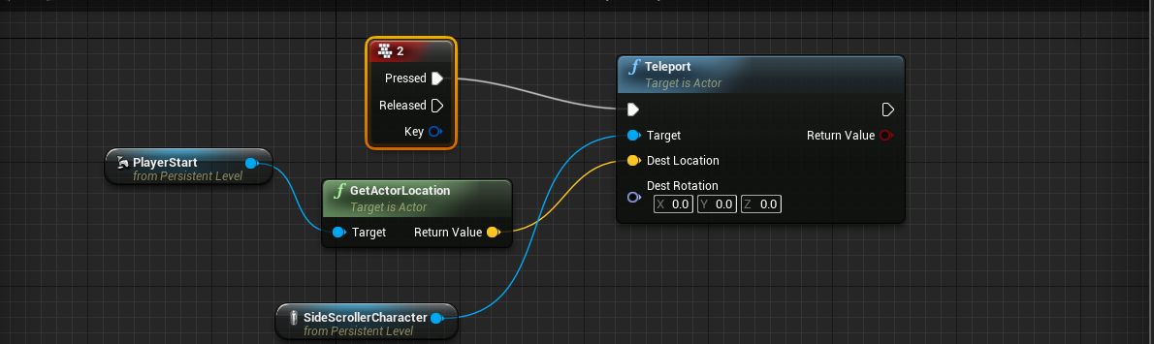
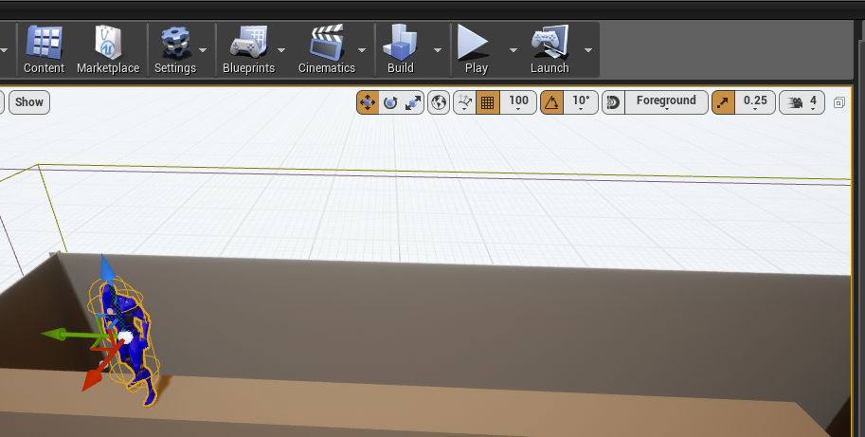
TESTING & EDITING TIPS
To test your level quickly, place various PlayerStart actors and make the player teleport to those point by assigning teleportation to each to a key press in Level Blueprint.
Use a grid of 100 for moving objects.
Always work at a fixed X coordinate (X=1200)

Slide 38
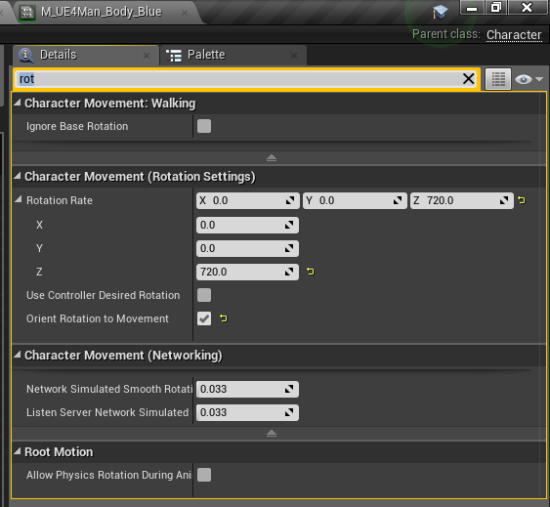
BP_ENEMY:
Create a new Blueprint class and choose “Character” as the parent class. Name it “BP_ENEMY”.
This class will be the base class for all diferent type of enemies.
Copy the skeletal mesh setup and relative coordinates from SideScrollerCharacter:
Skeletal Mesh: SK_Mannequin
Location (0,0,-95) Rotation (0,0,-90)
Anim Class (Use Animation Blueprint) ThirdPerson_AnimBP_C
Materials (Element 0): Browse to it and create a Material Instance. Change Body Color to get Blue,Red.
Character Movement => Orient Rotation to Movement (0,0,720)

Slide 39
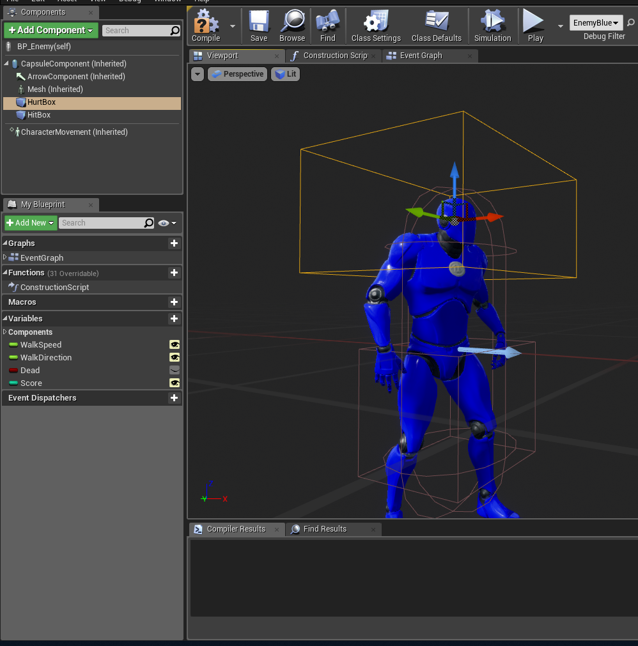
BP_ENEMY:
Add Hit and HurtBoxes (Box Collision)
HitBox will damage player on overlap.
HurtBox will cause the enemy to get killed.
Add WalkSpeed(20) and WalkDirection(-1) float variables.

Slide 40
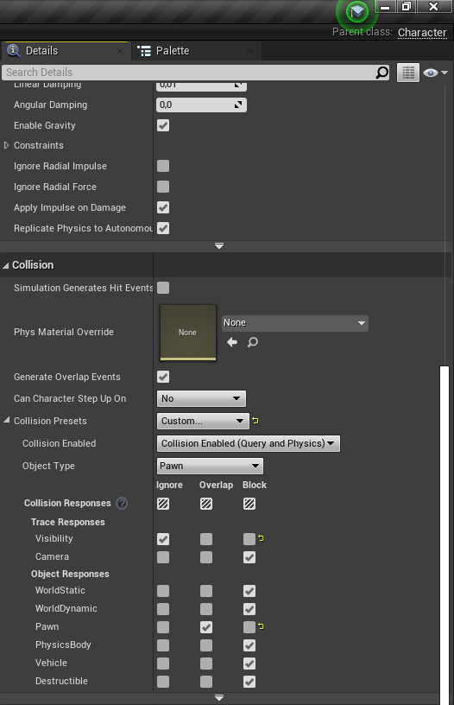
BP_ENEMY:
To make the enemy pass overlap/pass through the main player:
Select CapsuleComponent of BP_ENEMY.
Goto “Details” panel.
Scroll down to Collision and set Collision preset to “Custom…”.
This way we can specifically set the behaviour for what happens when 2 pawns collide. We no longer want them “Block” each other but “Overlap”.
Check box “Overlap” for Pawn.

Slide 41
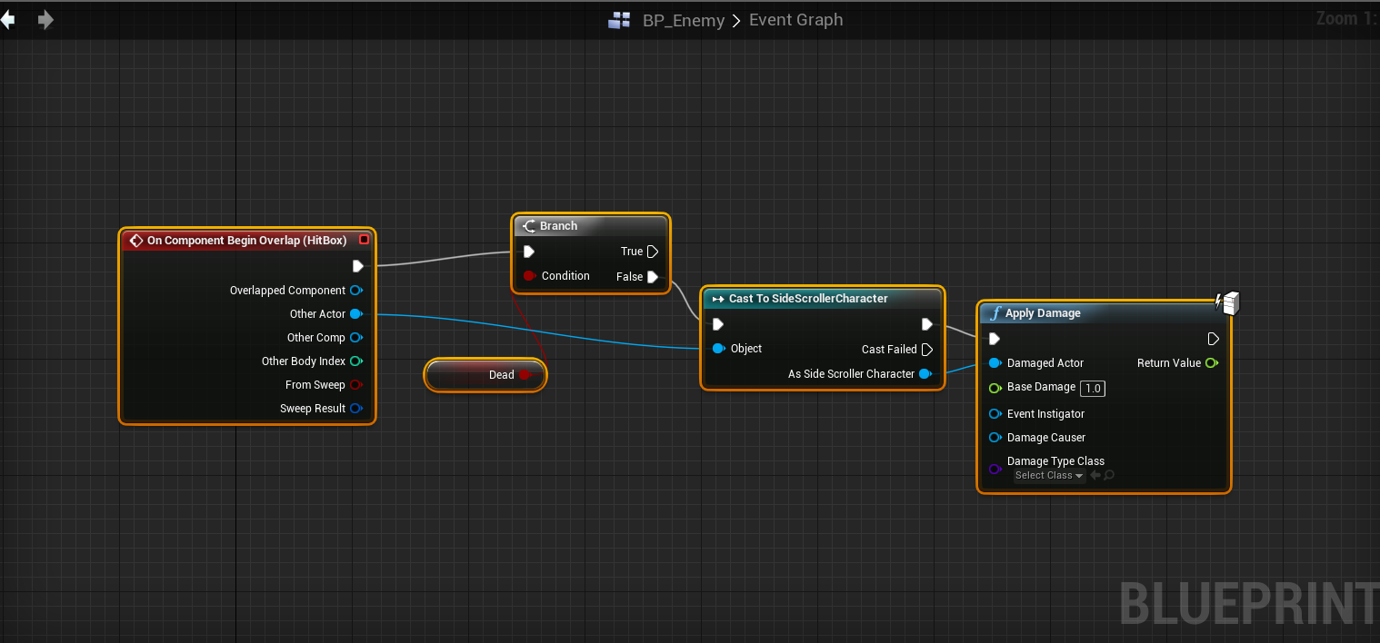
BP_ENEMY OVERLAPS:
Add ComponentBeginOverlap to HitBox
Use “ApplyDamage” interface of Actors for 1 damage.

Slide 42
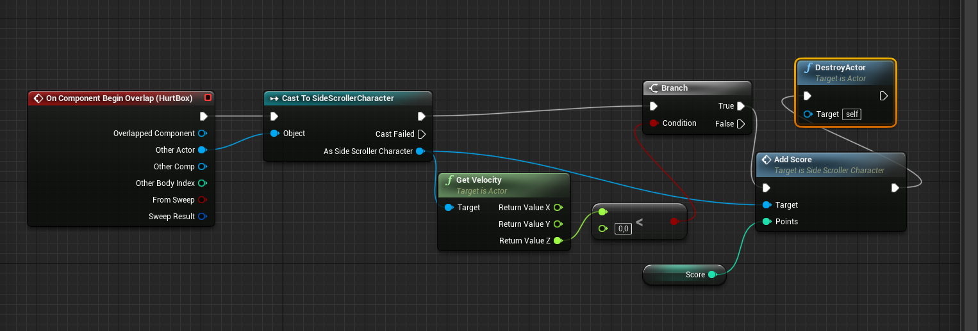
BP_ENEMY OVERLAPS:
Add ComponentBeginOverlap to Hurtbox
Check if the players velocity is negative on Z axis (falling)
If yes, destroy self, give score to player.

Slide 43
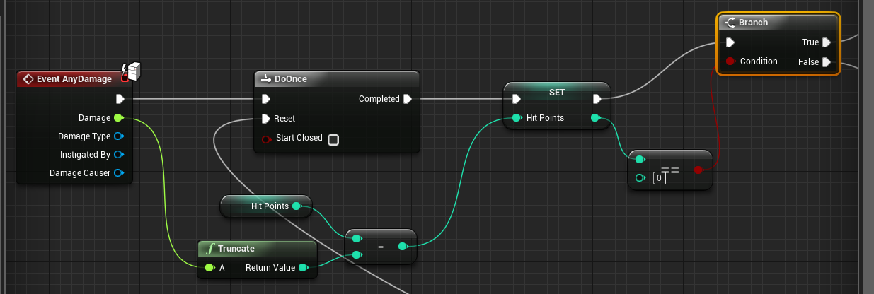
DAMAGE PLAYER
Add Event AnyDamage to SideScrollerCharacter.
Check if hitpoints reached to zero.
If yes, destroy self, set GameOver flag to true.

Slide 44
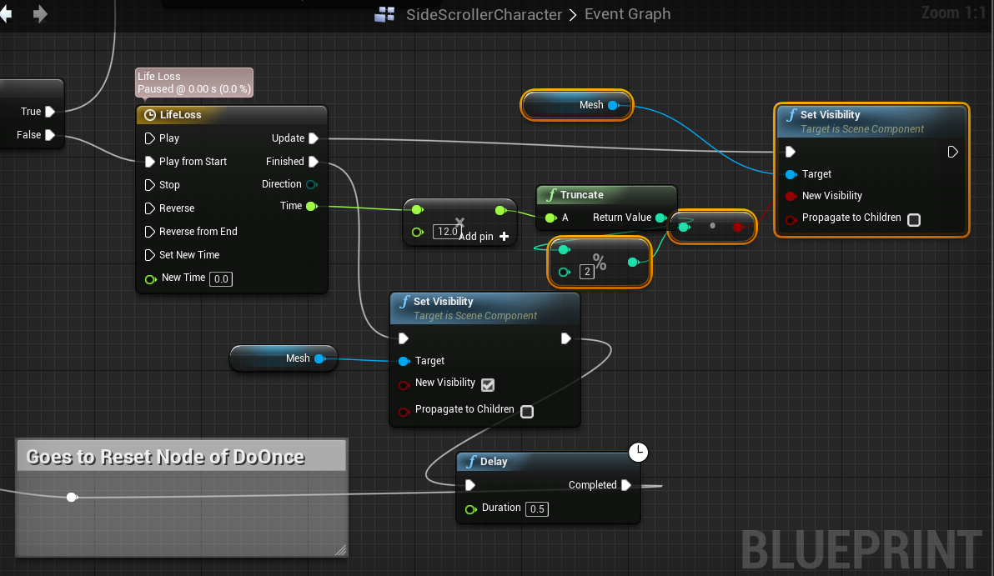
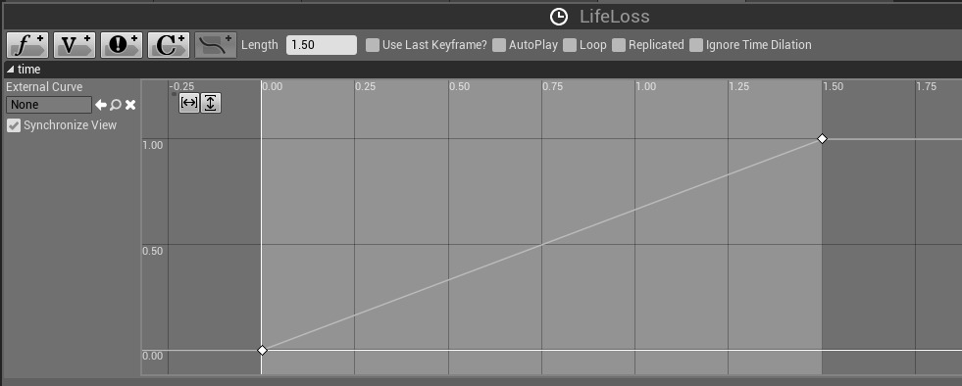
BLINKING ANIMATION
When the player loses one hitpoint, they blink for 1.5 seconds and became invulnerable.
Add a timeline and set visibility of the mesh component continuously.
At the end of the animation, DoOnce node is reset thus allowing the player to get damaged again.

Slide 45
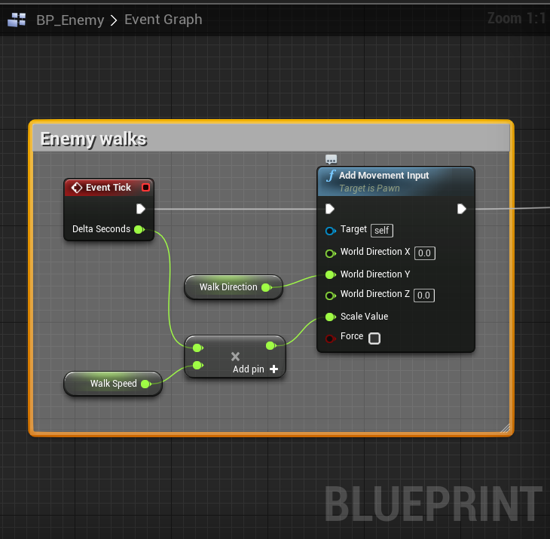
BP_ENEMY CHECK (1/3):
Make the enemy walk continuously in Tick event.

Slide 46
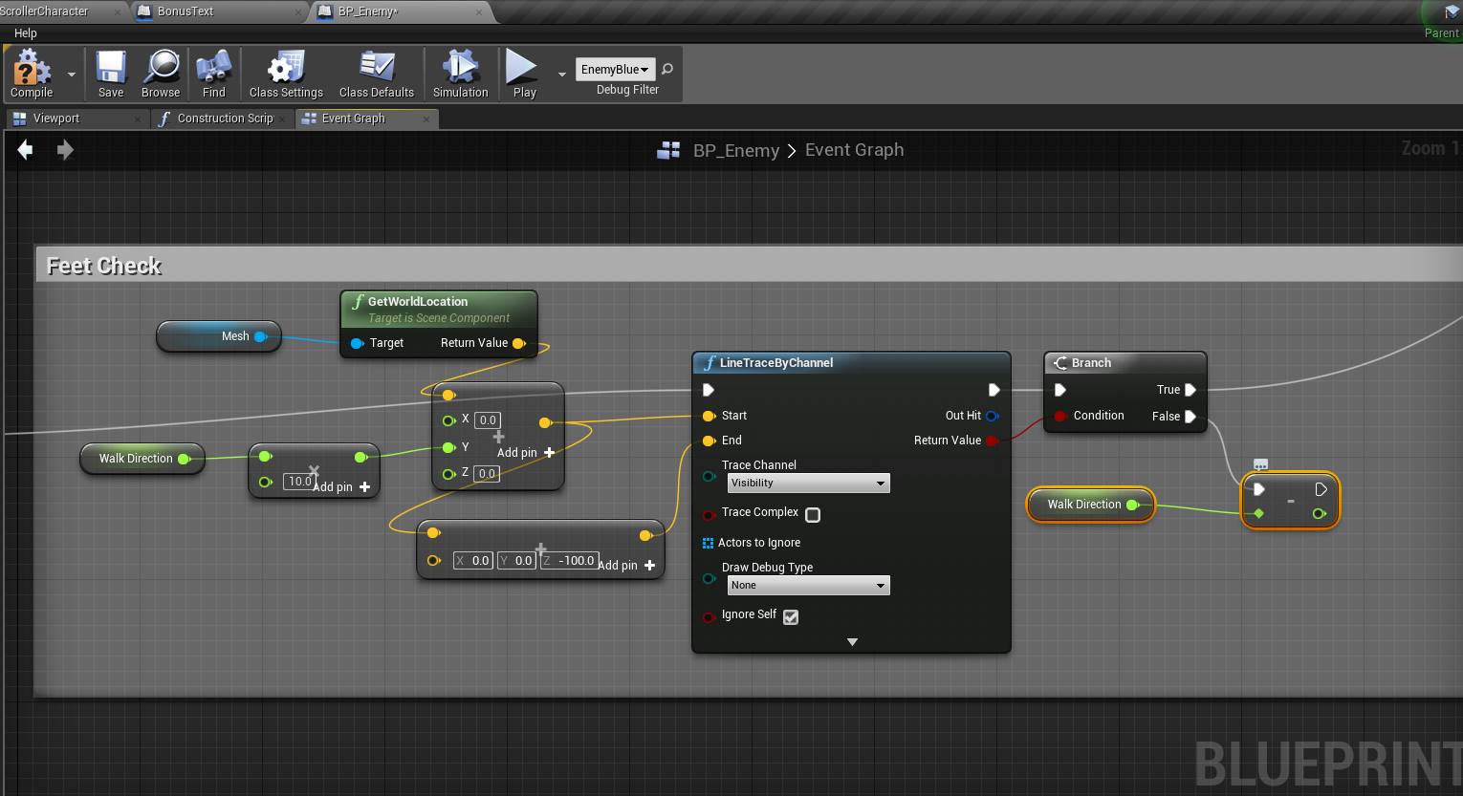
BP_ENEMY CHECK (2/3):
Check for feet if we have reached the end of a platform.
If so then chance walking direction.

Slide 47
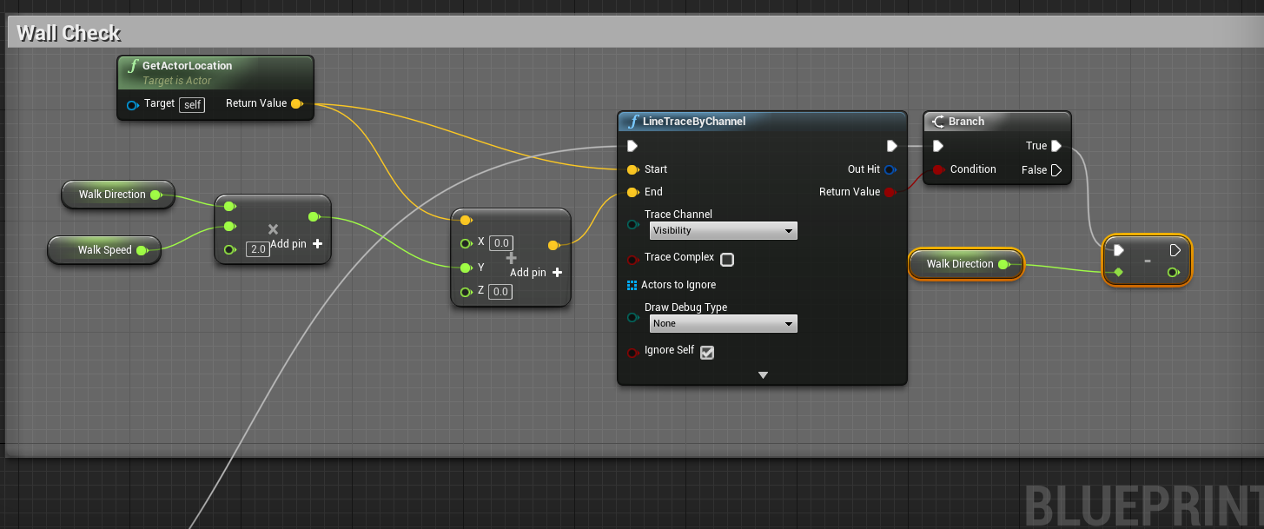
BP_ENEMY CHECK (3/3):
Check for walls.
If so then chance walking direction.

